Slide 1
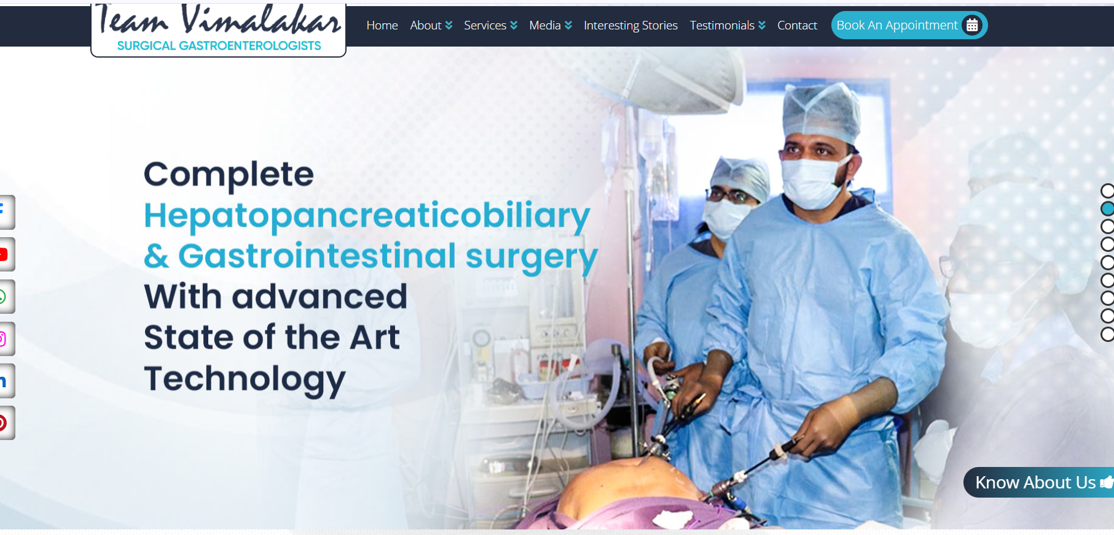
Add robo pics in this slides

Slide 2
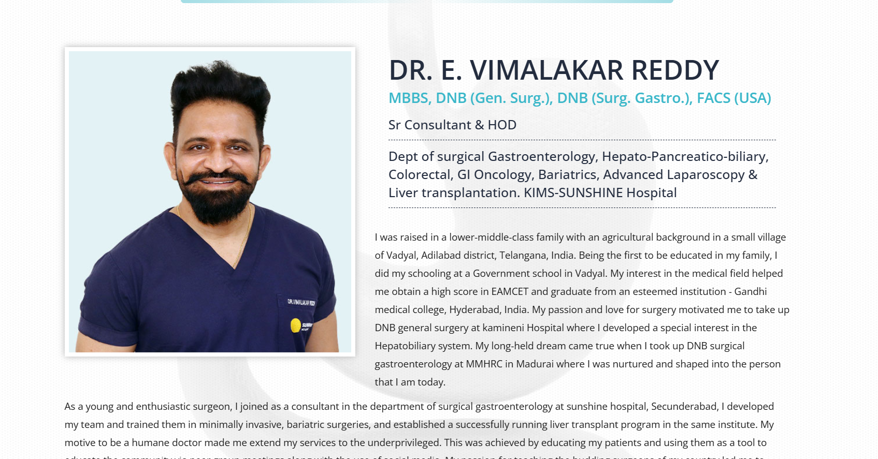
Dr. E. Vimalakar Reddy
MBBS, DNB (Gen. Surg.), DNB (Surg. Gastro.), FACS (USA)
Sr Consultant & HOD
Dept. of Surgical Gastroenterology, Hepato-Pancreatico-Biliary, Colorectal, GI Oncology, Bariatrics, Advanced Laparoscopy & Liver Transplantation
Apollo Hospitals, Jubilee Hills, Hyderabad
I was raised in a lower-middle-class family with an agricultural background in the small village of Wadyal, Adilabad district, Telangana, India. Being the first to be educated in my family, I did my schooling at a Government school in Wadyal. My interest in the medical field helped me obtain a high score in EAMCET and graduate from an esteemed institution – Gandhi Medical College, Hyderabad, India. My passion and love for surgery motivated me to take up DNB General Surgery at Kamineni Hospital, where I developed a special interest in the hepatobiliary system. My long-held dream came true when I took up DNB Surgical Gastroenterology at MMHRC in Madurai, where I was nurtured and shaped into the person that I am today.
As a young and enthusiastic surgeon, I joined Sunshine Hospital, Secunderabad, as a Consultant in the Department of Surgical Gastroenterology. Over the years, I developed my team and trained them in minimally invasive and bariatric surgeries, and established a successfully running liver transplant program at the same institute. Six years after joining Sunshine Hospital, the institution became KIMS-Sunshine Hospitals, where I continued my journey and expanded my clinical, academic and surgical practice. After a decade of dedicated service with the institution, I moved to Apollo Hospitals, Jubilee Hills, Hyderabad, in 2026, marking the beginning of a new chapter in my professional journey.
My motive to be a humane doctor made me extend my services to the underprivileged. This was achieved by educating my patients and using them as a tool to educate the community via peer group meetings, along with the use of social media. My passion for teaching the budding surgeons of my country led me to organize numerous workshops on various intricate surgeries, publish numerous articles, and give lectures in both national and international forums in the simplest of languages to help people understand them better. I serve as the chief reviewer for both national and international journals and serve as a primary investigator for numerous current studies. I have authored many topics in surgical gastroenterology textbooks.
My love for poetry led to composing many poems in my mother tongue (Telugu), and I later released a book, “Kavi Rayani Kavithalu.” I have been honored with “Vaidya Shree” and “Best Doctor” awards in the year 2020. In the year 2021, I was given the title Fellow of the American College of Surgeons (FACS).
Update the Bio to this.

Slide 3
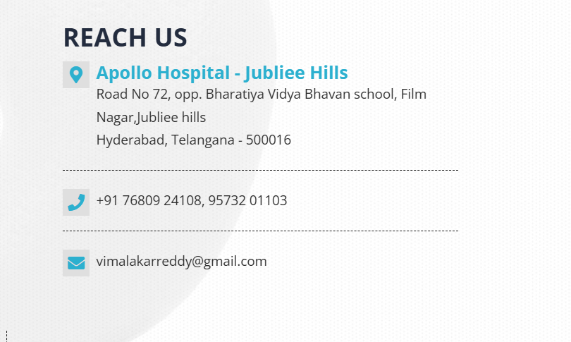
Put correct pincode of Jubilee hills

Slide 4

Add Robotic assisted surgery

Slide 5
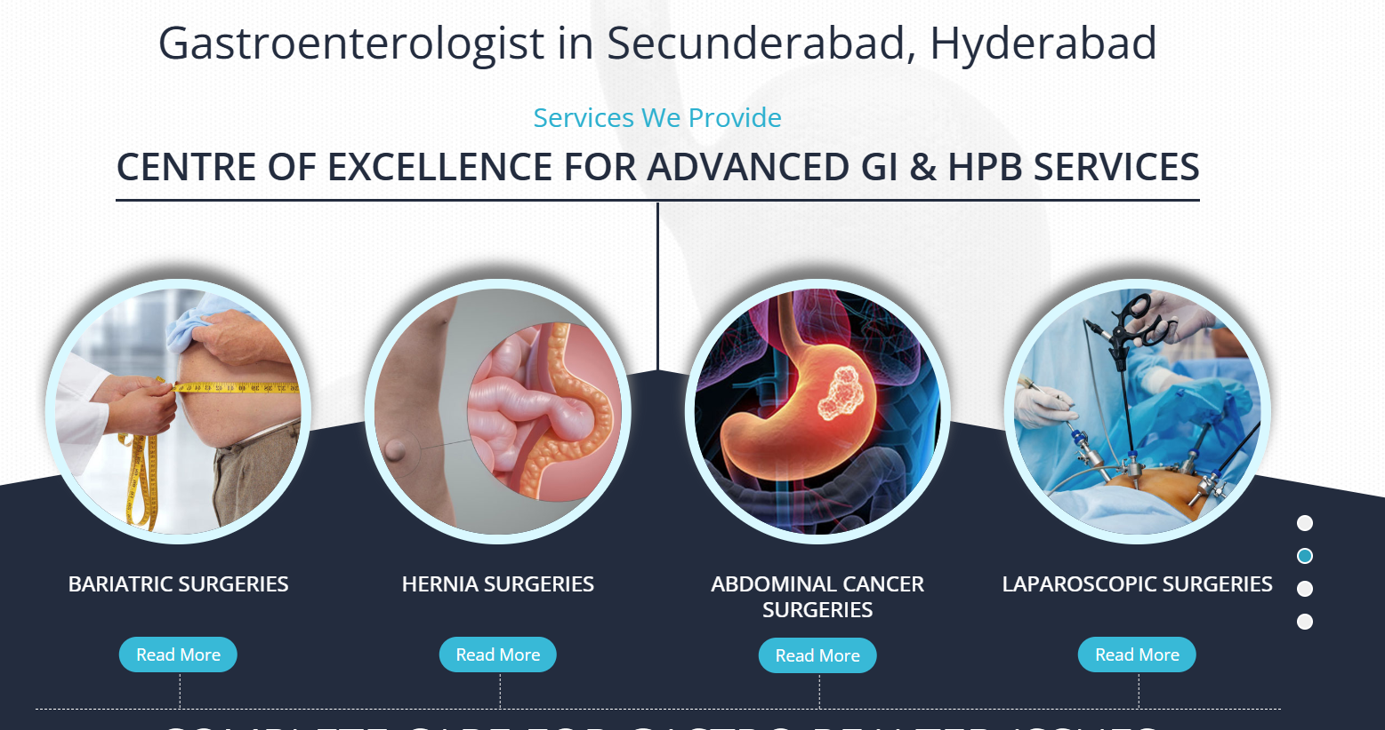
Remove secunderabad.
Add robotic surgery in circles

Slide 6
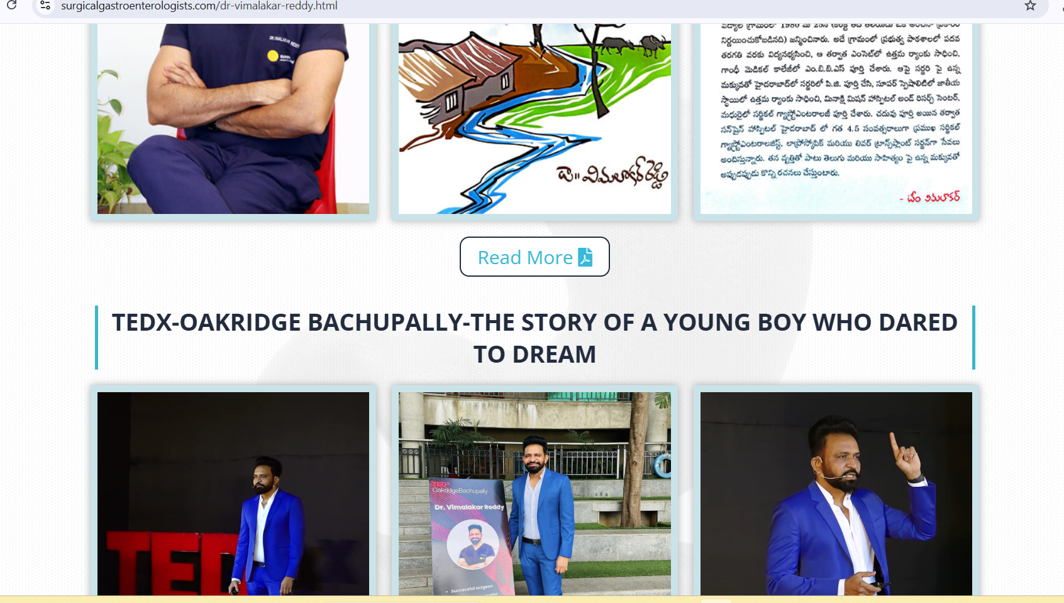
Put Ted book 1st , followed by Telugu book

Slide 7
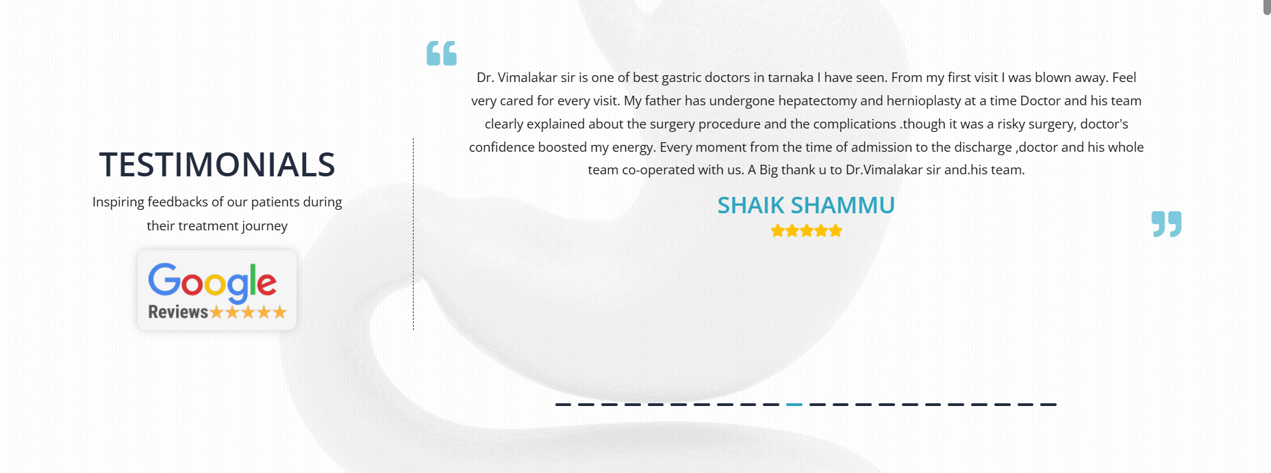
Take new reviews and add

Slide 8
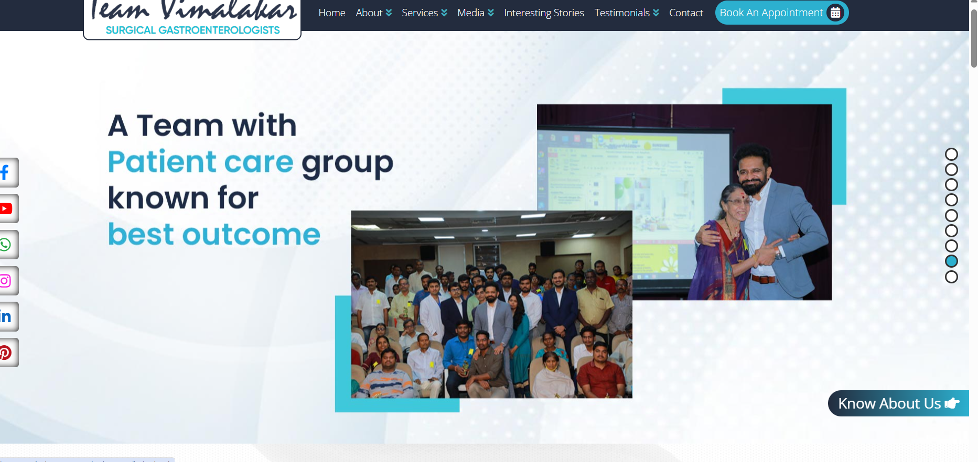
Add new photos

Slide 9

Add some new photos

Slide 10
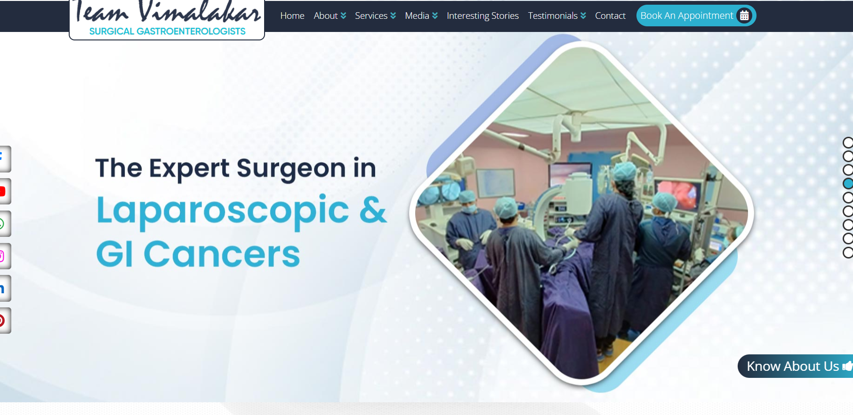
Add robotic photos and matter

Slide 11
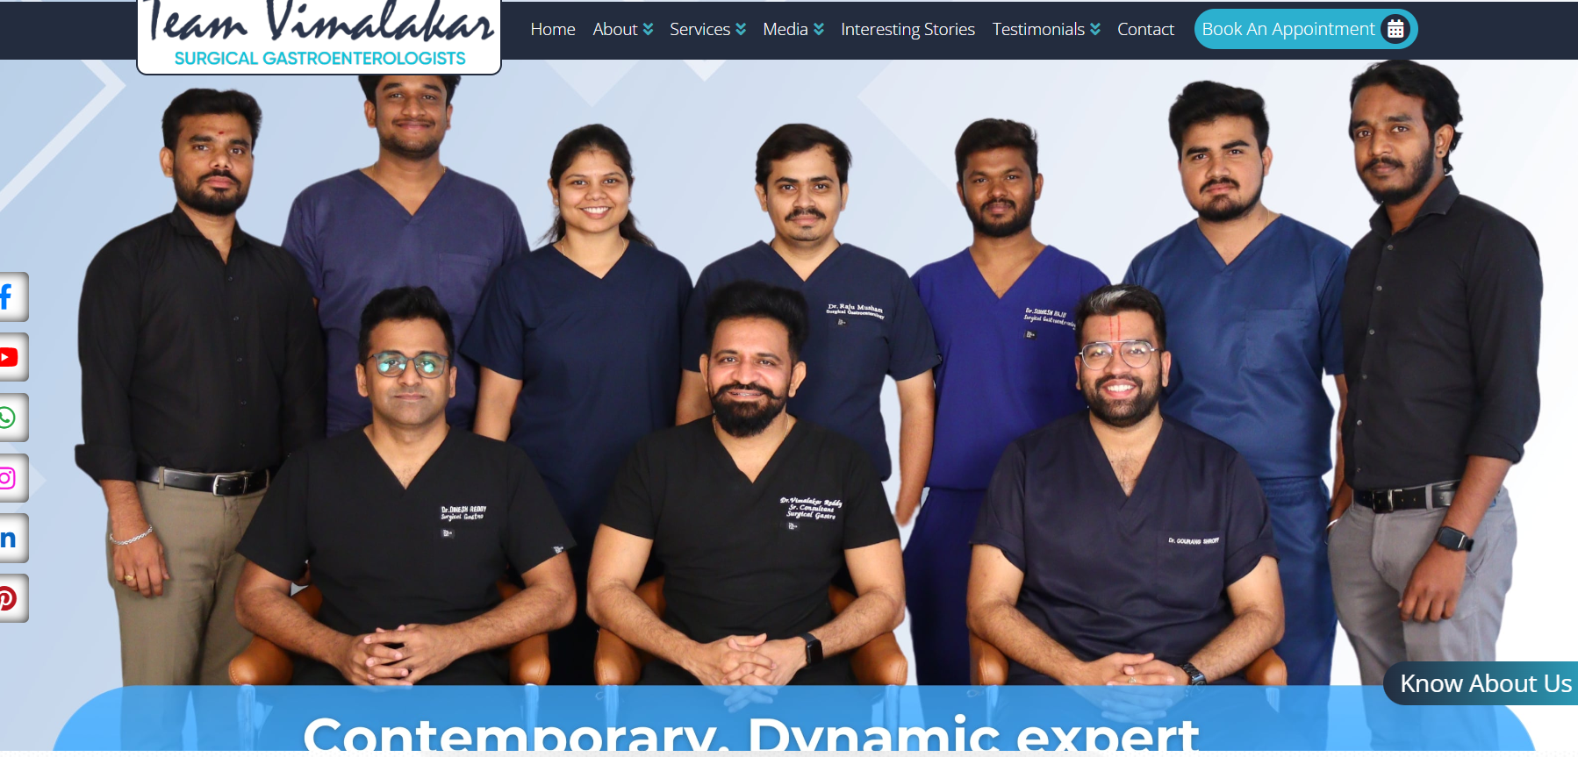
Change Team Photo

Slide 12
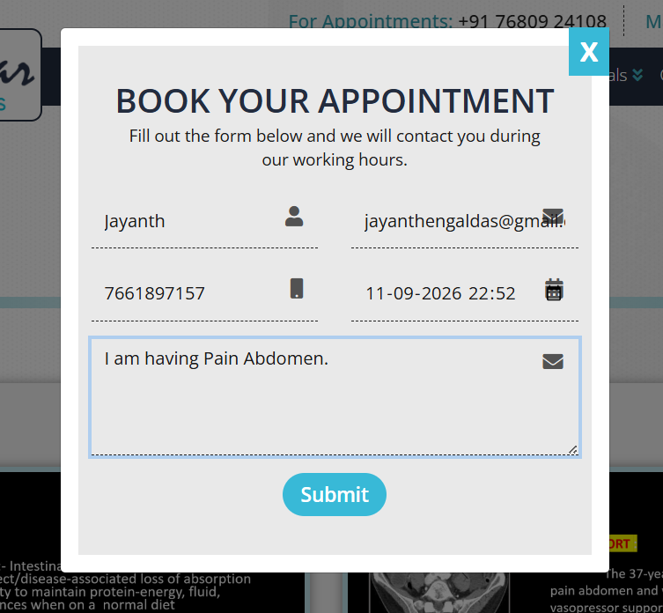

Add
Add Date of appointment preview here

Slide 13

Change mail everywhere in website to
teamvimalakar@gmail.com

Slide 14

Let me know where I can see if anyone booked slot

Slide 15
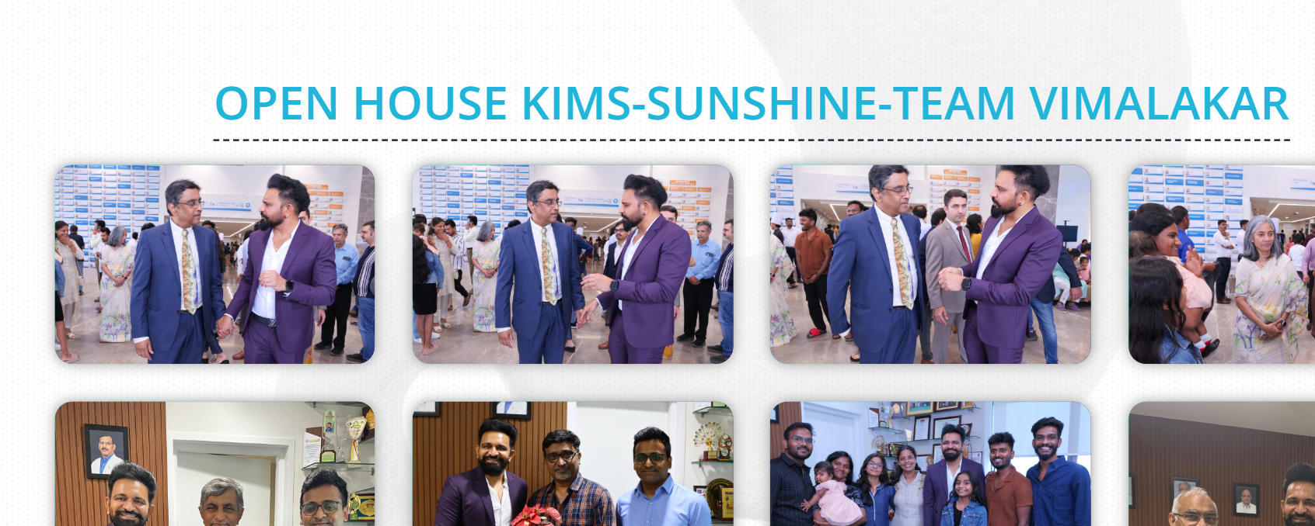

Remove 2 photos , 1st one is enough

Slide 16
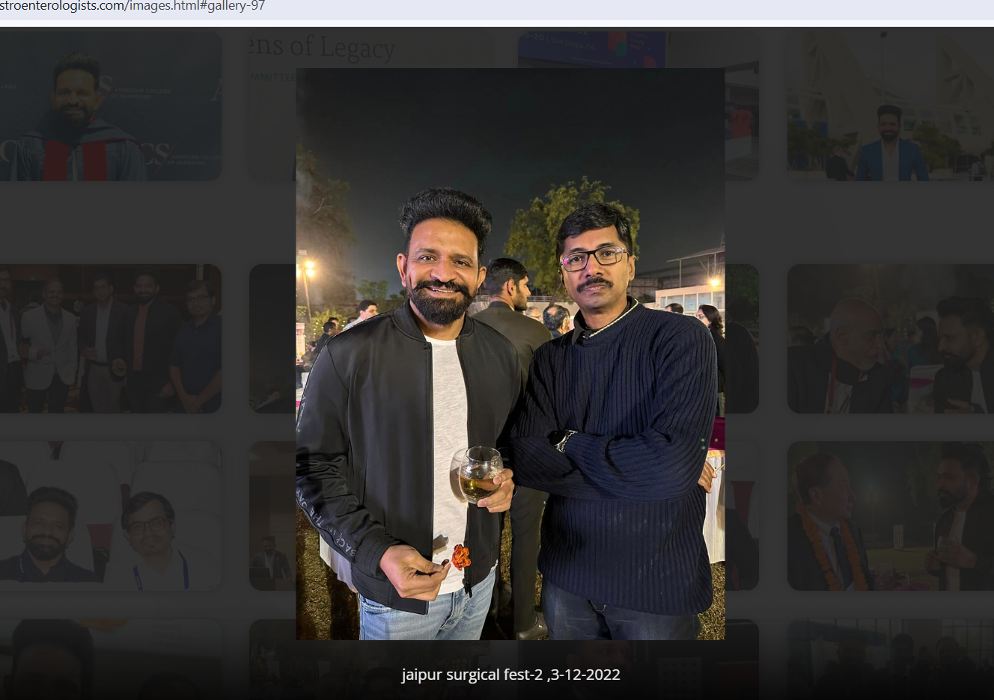
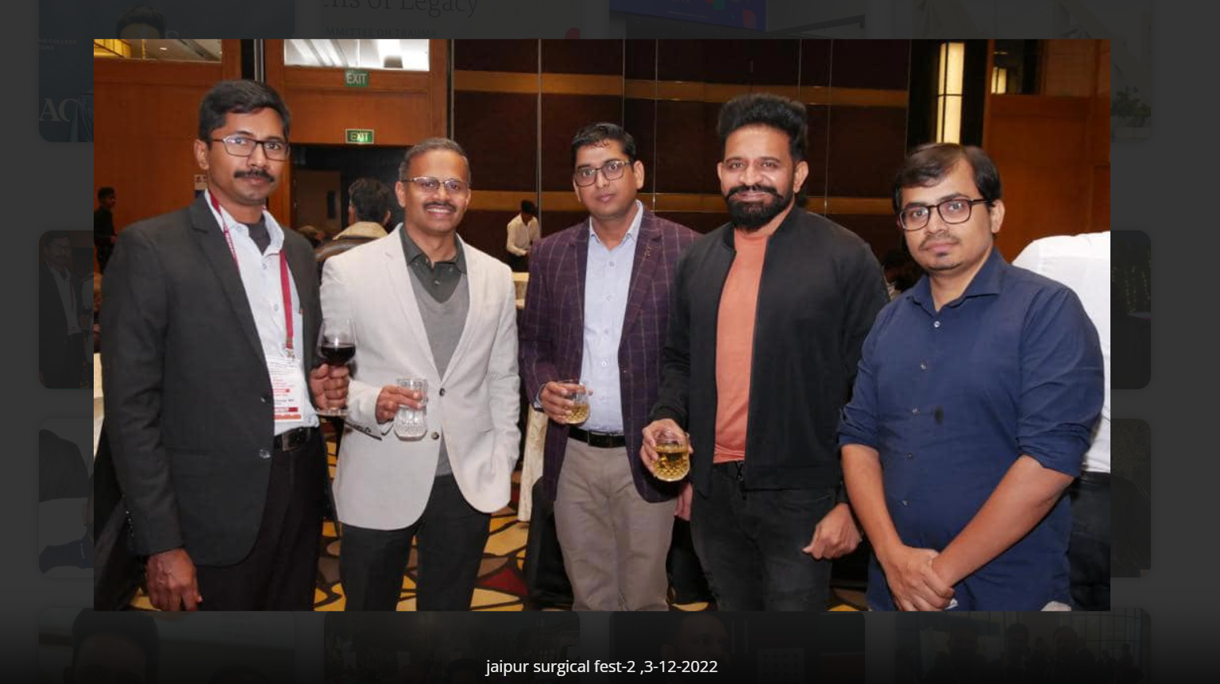
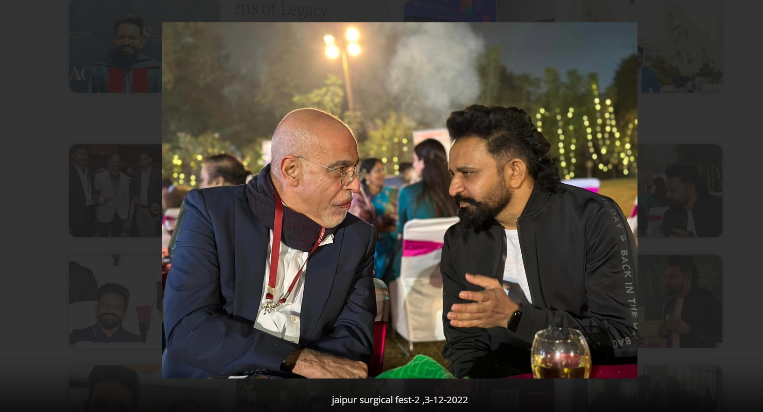
Remove photos holding alcohol

Slide 17
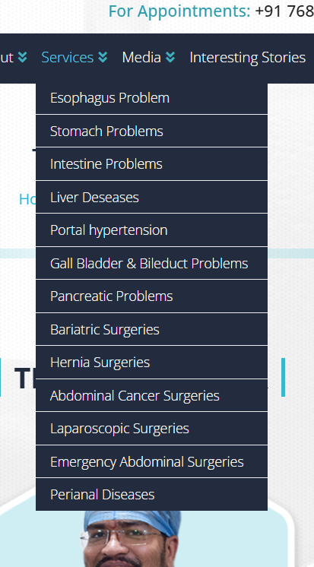
Add Robotic surgeries option here with content inside it

Slide 18
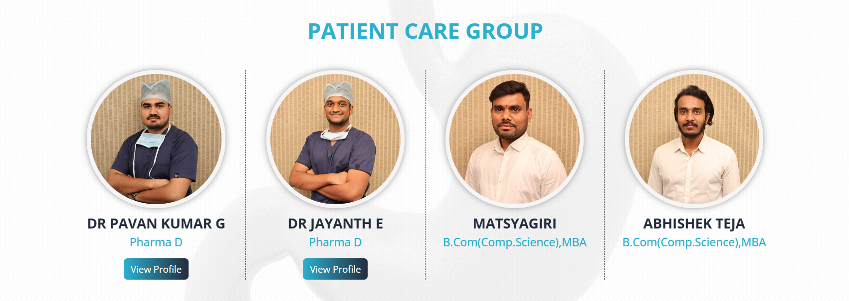
Dr. Jayanth Engaladas
Clinical Assistant
Matchyagiri M
Secretary
Change all photos & add description as I mentioned.
Dr. Pavan Kumar G
Clinical Assistant
Abhishek Teja G
Manager

Slide 19
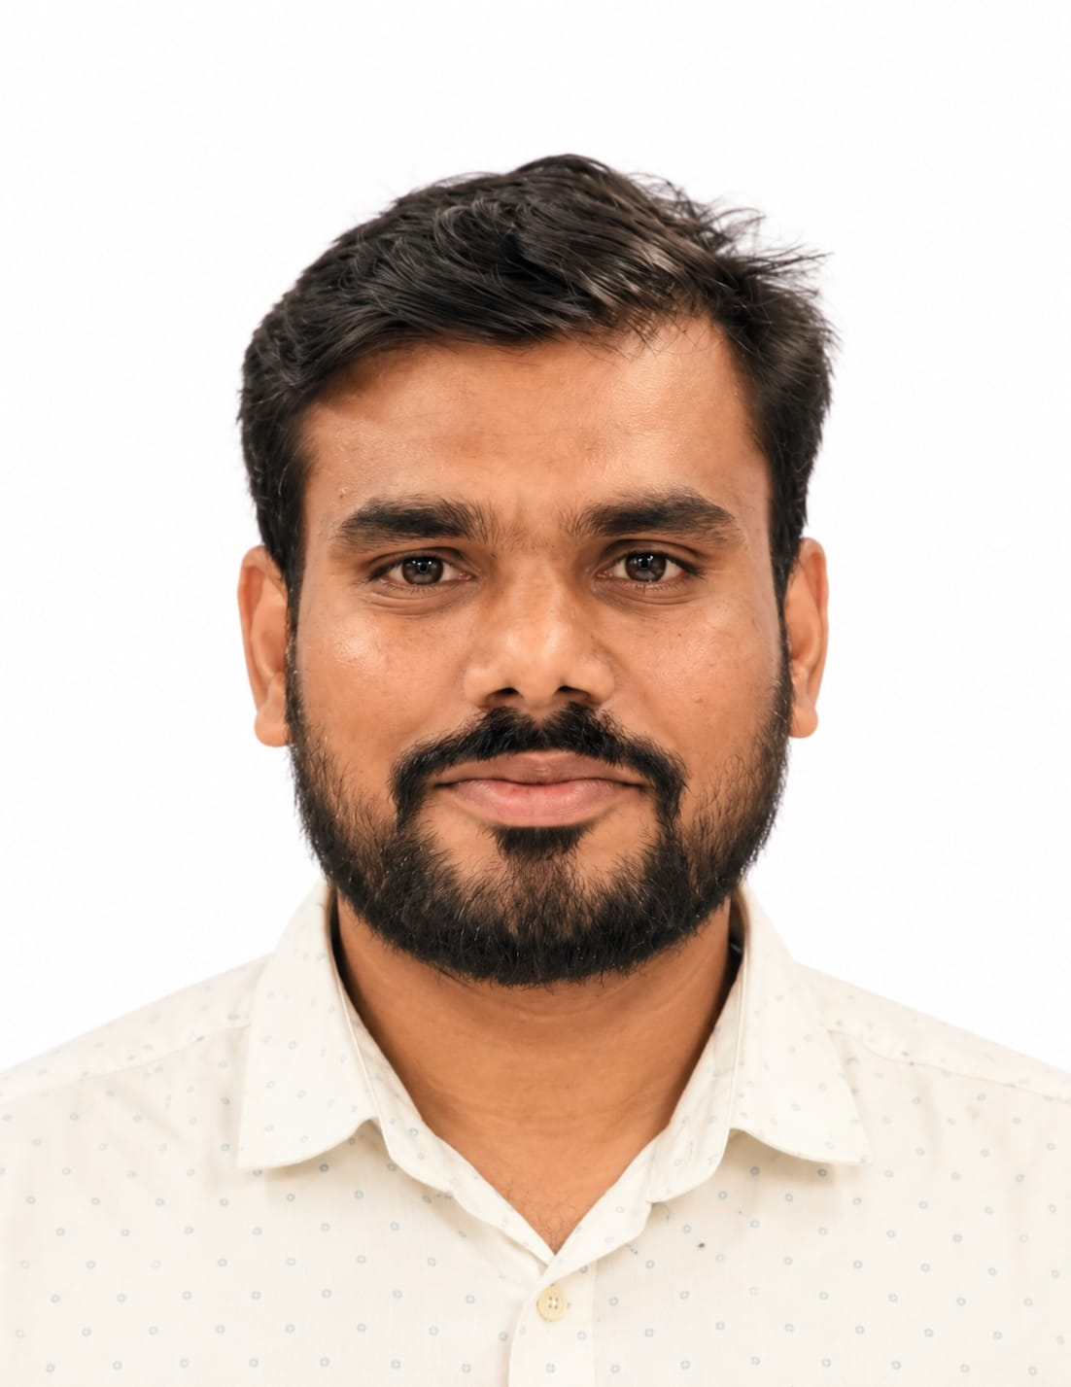
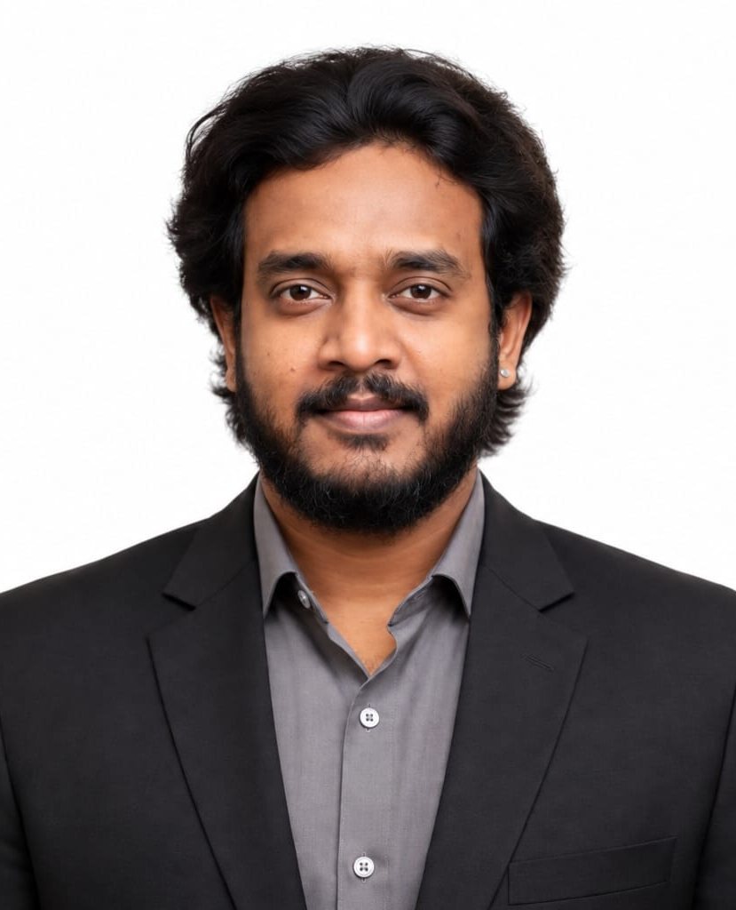
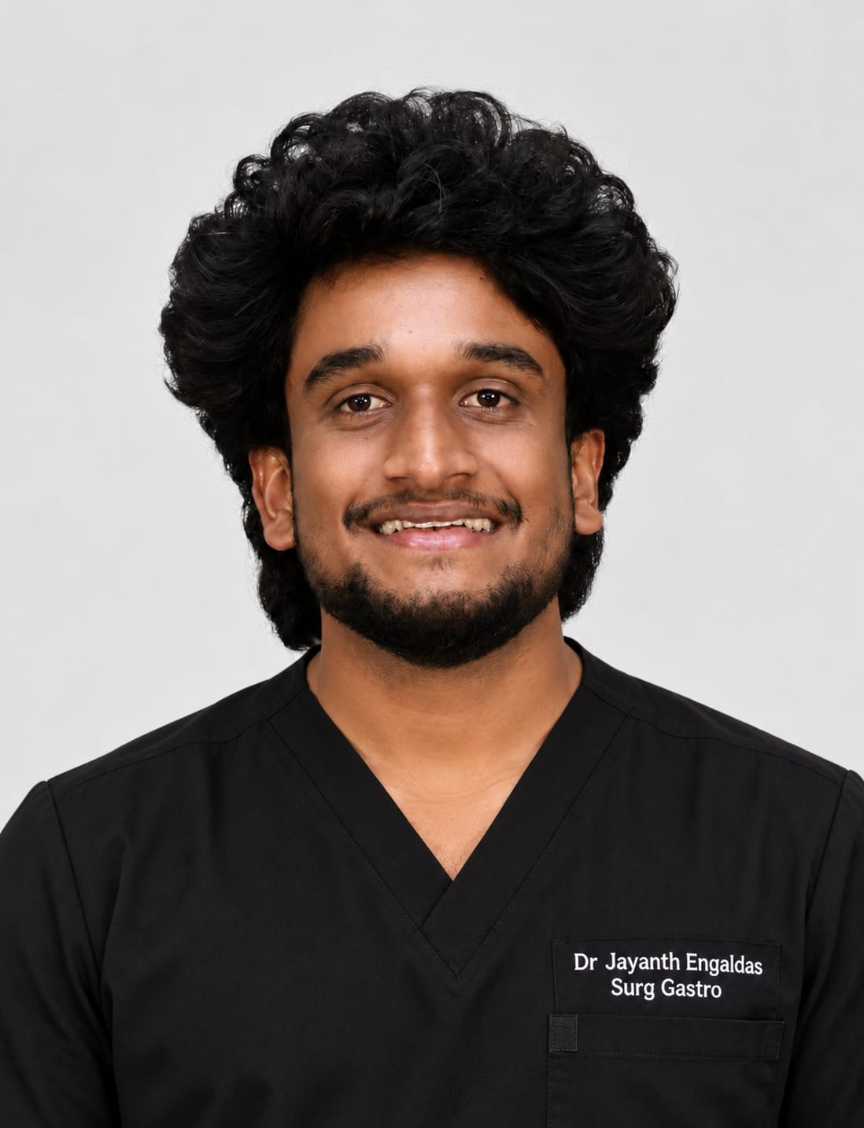
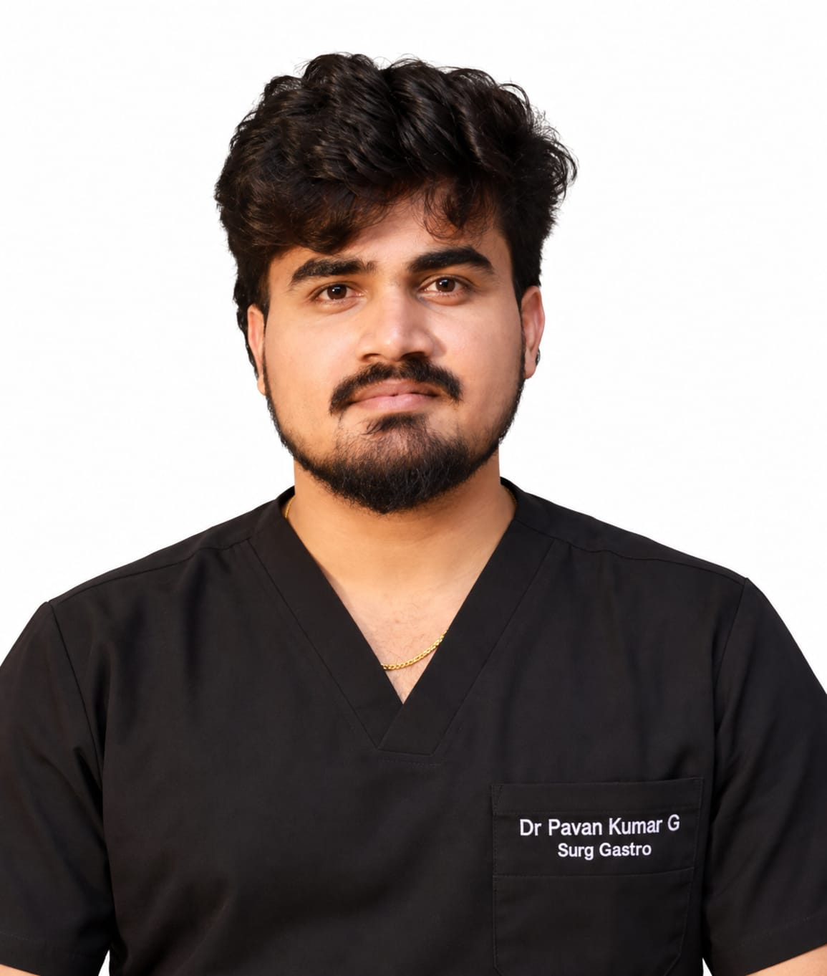
Update all photos

Slide 20
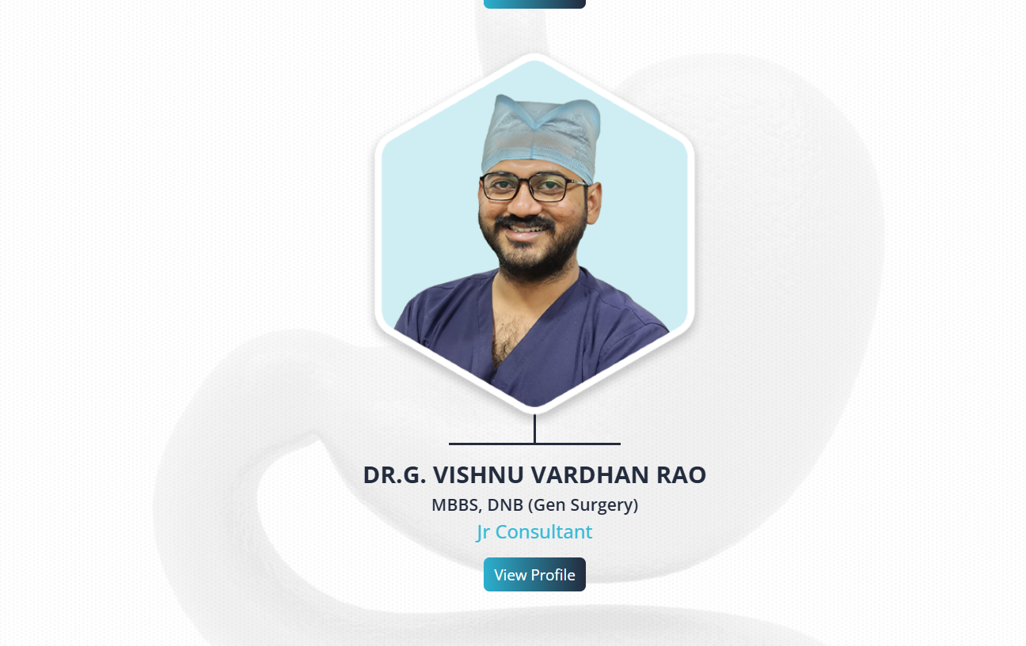
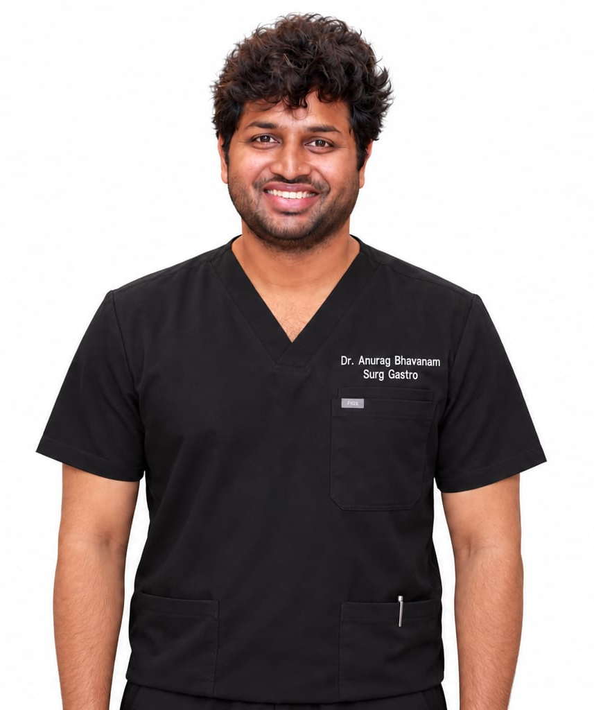
Remove Dr. Vishnu Completely & Add Dr. Anurag Bhavanam Instead
Let the degrees be same

Slide 21
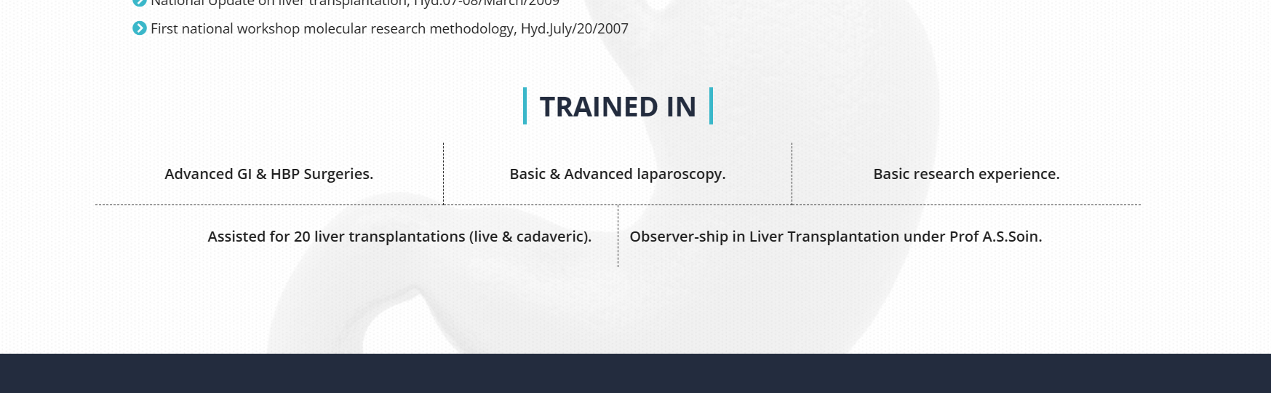
Add robotic surgeries

Slide 22
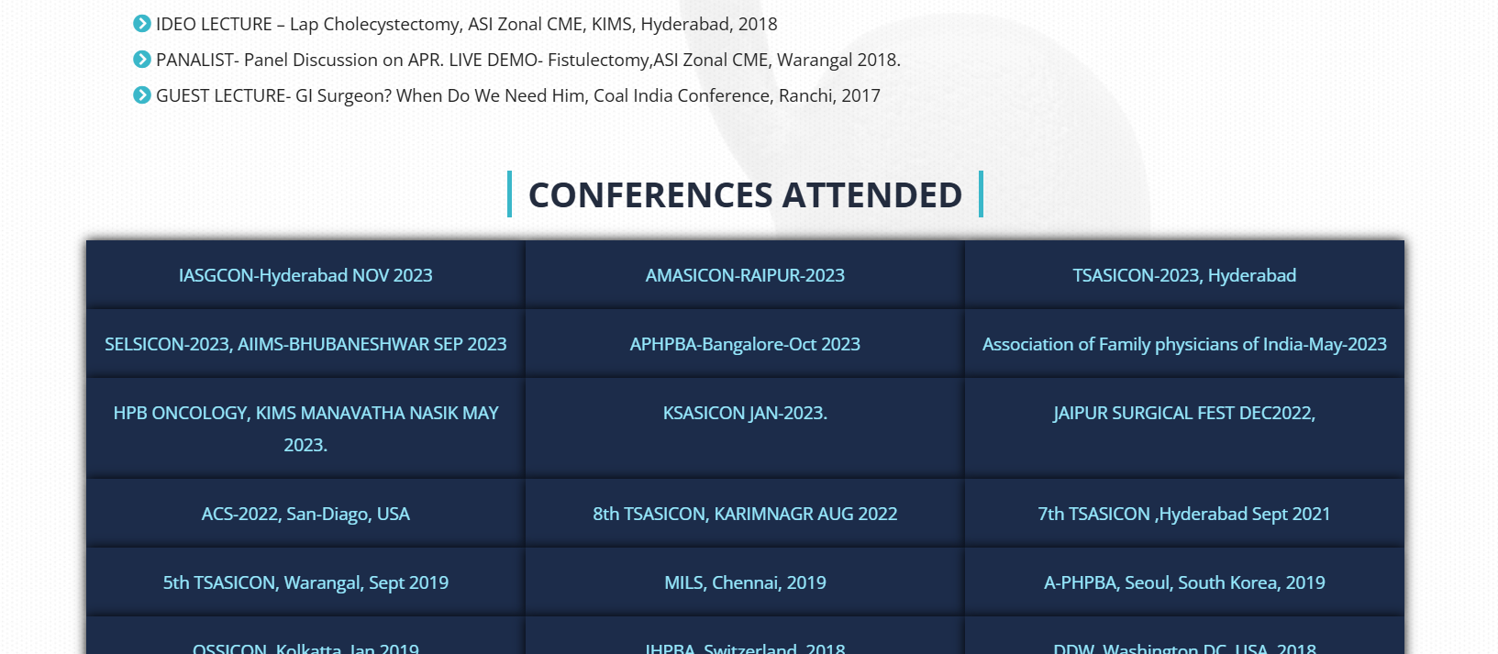
Update all the conferences attended since 2023

Slide 23
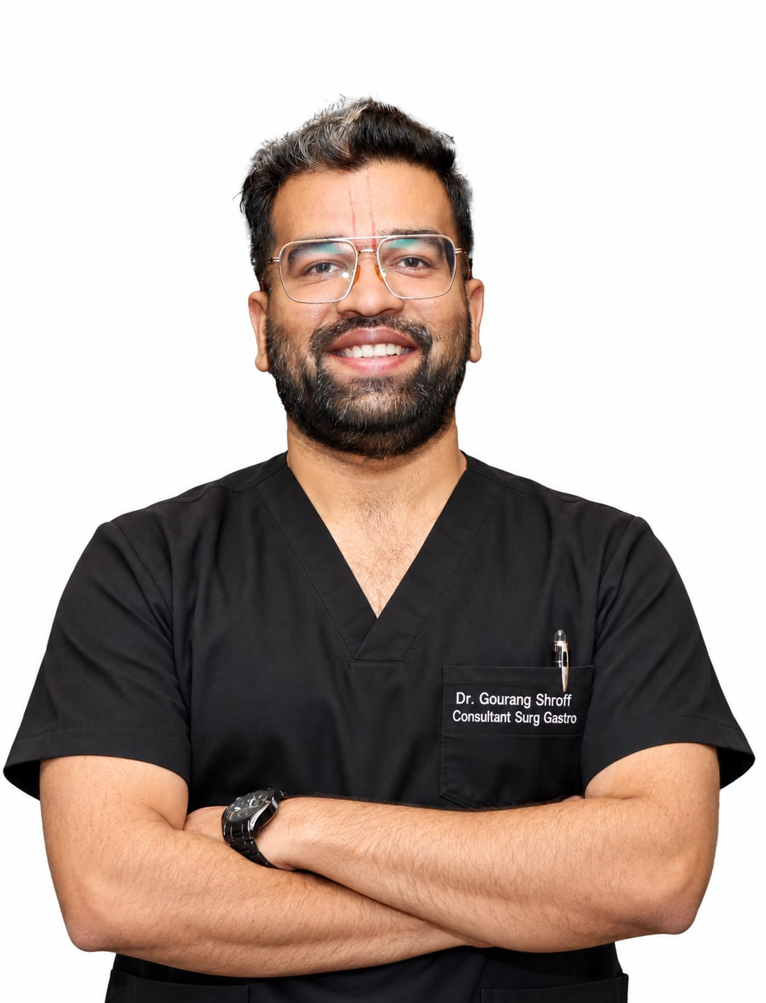
Update Dr. Gourang Photo

Slide 24
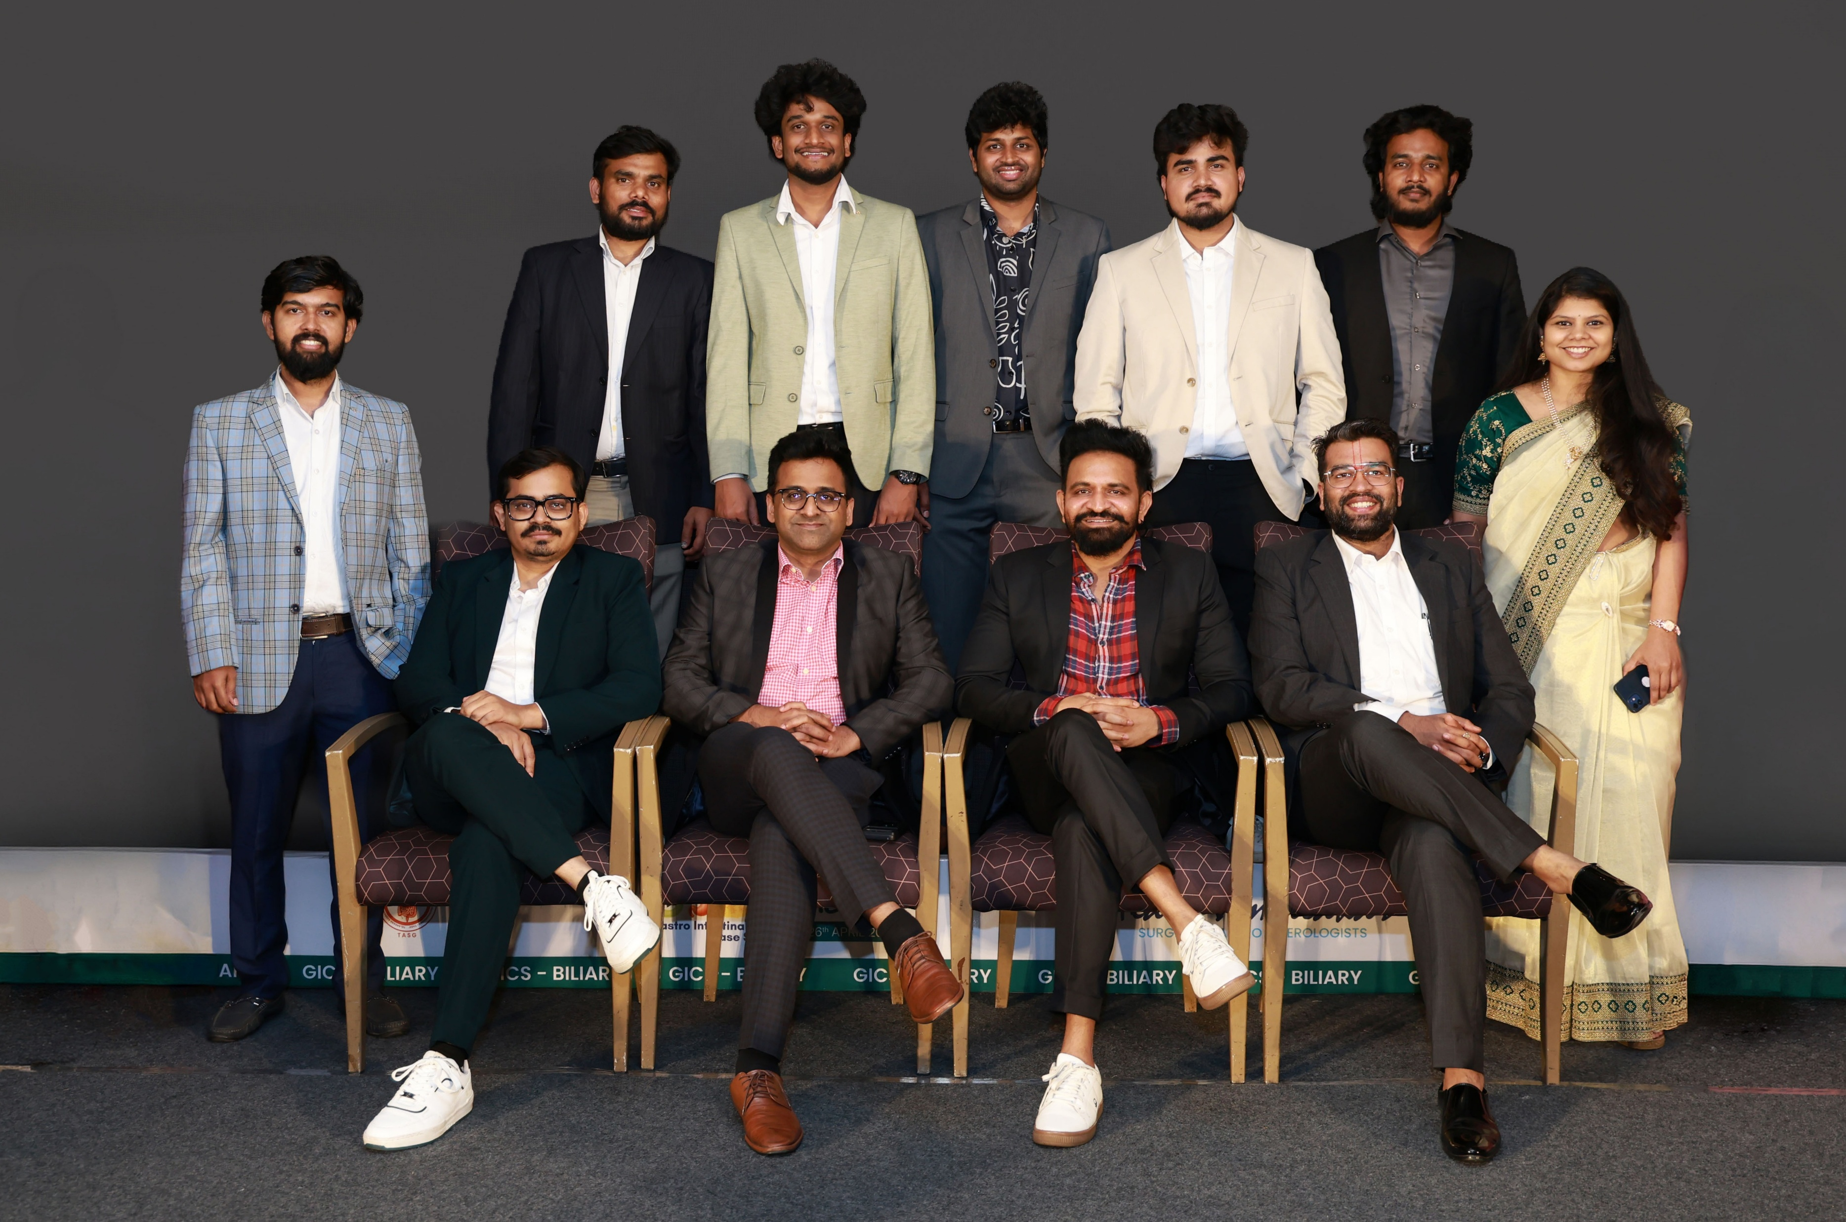
Team Photo

Slide 25
Update Papers, Publications, awards, faculty and all from the CV Provided to you.

